Slide 1
TVETMIS SUBMISSION: TIPS AND TRICKS
Prepared by: Mudau DR
EMIS Manager

Slide 2
Department Calendar
When you setup the system dates on Gops-1, use the departmental academic calendar.

Slide 3
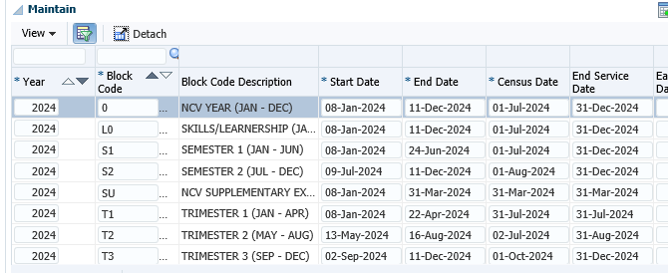
Maintain of Census Dates and extract the Census Report
Use Gops-1 to maintain the Census dates

Slide 4
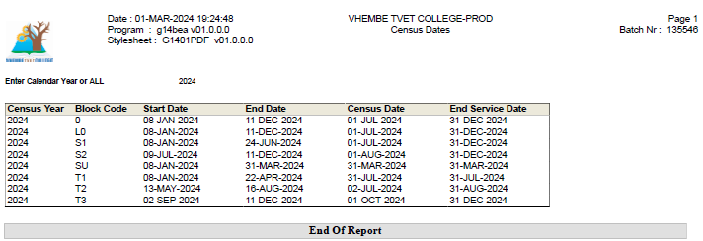
Census Report
User GOPSR1-2

Slide 5
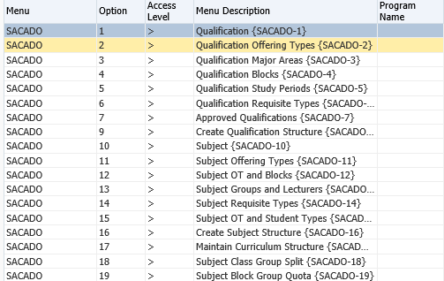
Qualifications and Subjects structure maintenance.

Slide 6
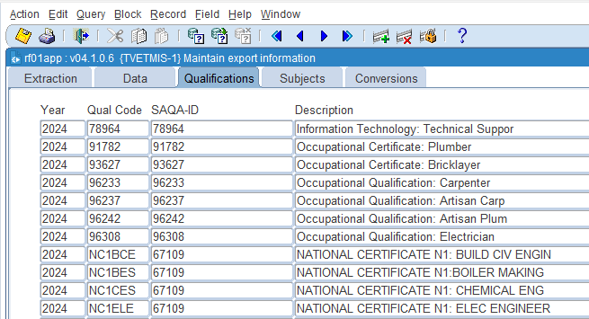
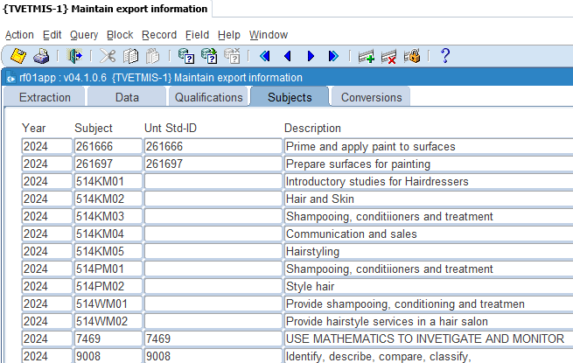
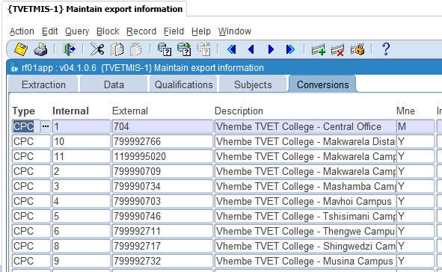
Verify the Qualifications; Subjects and Conversions internal codes linked to external codes

Slide 7
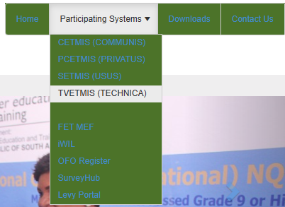
Important Website with external codes:
TVETMIS (dhet.gov.za)
Once you open the site, proceed as showed below:

Slide 8
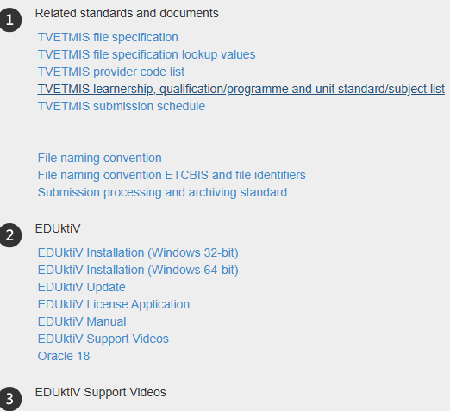
Importance links or tabs to open

Slide 9
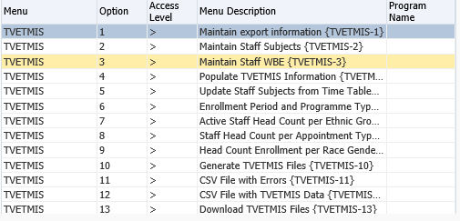
TVETMIS MENUS AND OPTIONS

Slide 10
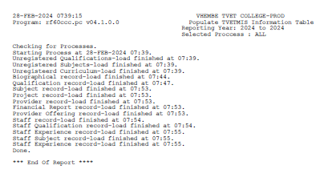
Populating TVETMIS Information Table and view the report

Slide 11
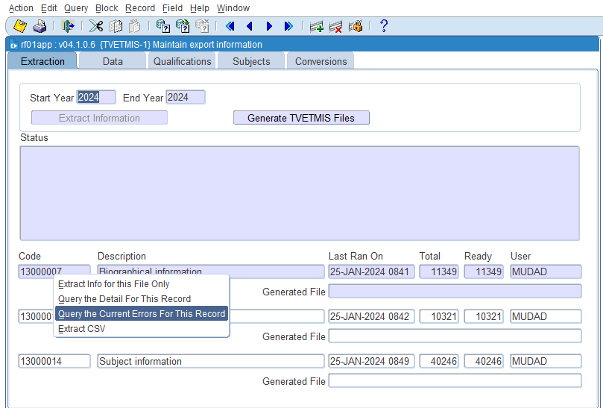
Extracting enrolment errors on TVETMIS-1 and fix
Before you generate TVETMIS files, you need to verify each Table code in order to conclude if each table is free of errors. The two figures that appears under the field Total and the field Ready that looks similar does not reveal that your table is clean, you need to go deeper. How?

Slide 12
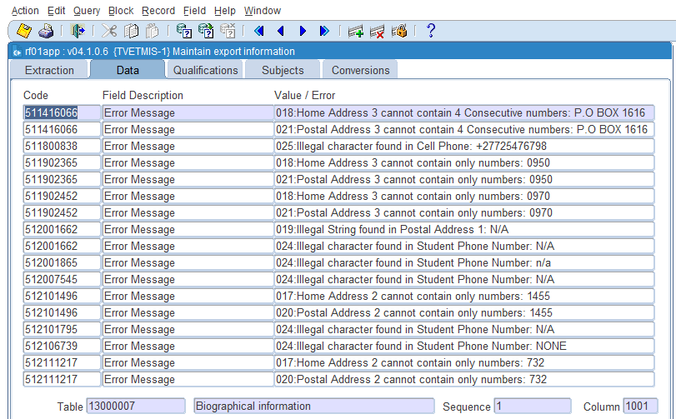
The errors are and need to be corrected. How?

Slide 13
How do you find the errors?
2024 BIO ERRORS_1.xlsx

Slide 14
TVETMIS-6_NC(V) FULL TIME ENROLMENT

Slide 15
Generate TVETMIS files
Use TVETMIS-1 or TVETMIS-6
Use FileZilla to download or to move the files to the directory of your choice.

Slide 16
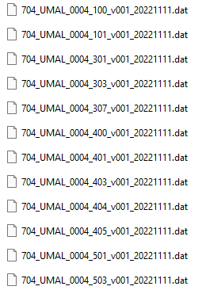
Generated TVETMIS files to be uploaded to EdUktiv Application

Slide 17
How to open the Dat file using EXCEL Application
Open an Excel App,
Go to Data,
Get Data, from Text/CSV
Or use excel workbook

Slide 18
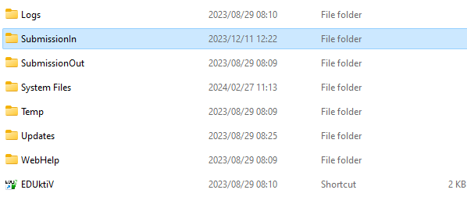
Copy all your DAT files to EduKTiv SubmissionIn directory

Slide 19
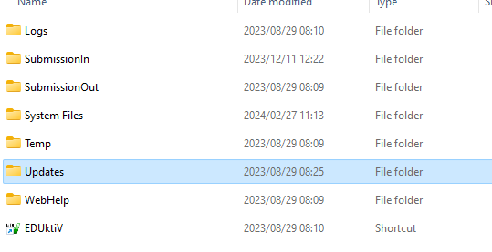
Copy the updates into EdukTiv Updates directory
Before you open EdukTiv App
Make sure you have copied the updates from TVETMIS websites and Paste the file on the Updates directory:

Slide 20
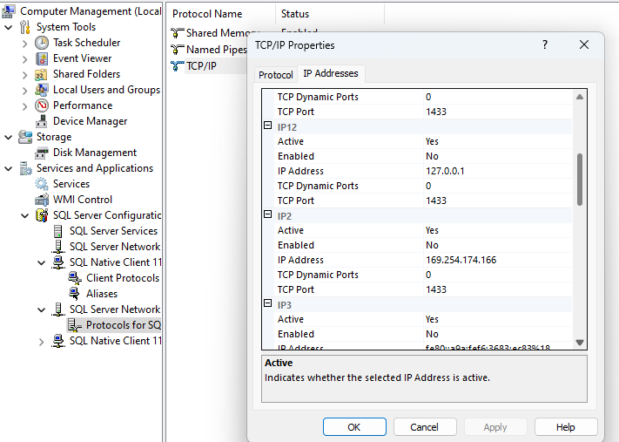
TCP Port Make sure that all the TCP port carries the value 1433 throughout.

Slide 21
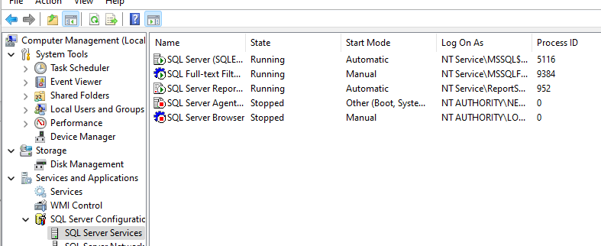
EduKTiv Applications services

Slide 22
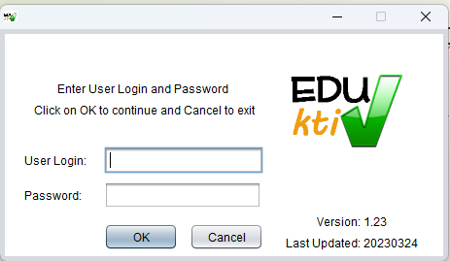
Open EdukTiv App and Validate TVETMIS files
Start your EduKtiv app

Slide 23
Comprehensive Report
Analyse the report you received against the data you submitted.
Analyse the report per block type, e.g NC(V), Trimester, Semester or Occupational/Skills

Slide 24
Log Files
What do you learn from the Log file?
Load_Log_704_UMAL_20210128.xlsx

Slide 25
Samples of extracted 2024 Actuals enrolment _ Jasper APP
2024 NCV_ENROLMENT_COLLEGE.xlsx
2024 SEMESTER ONE_ENROLMENT_COLLEGE.xlsx
2024 TRIMESTER ONE_ENROLMENT_COLLEGE.xlsx
2024 SKILLS_ENROLMENT_COLLEGE.xlsx

Slide 26
Thank you
NDI A LIVHUWA
Richard Mudau​​
0159637024​/0769239184/0636266519
Email Address: Mudau.dr@vhambecollege.edu.za
Website: www.vhembecollege.edu.za
Online Application: https://ienabler.vhembecollege.edu.za/pls/prodi41/gen.gw1pkg.gw1startup?x_processcode=ITS_OAP
Central Application Services: https://www.cas.ac.za
​

